Slide 1

by Mike Quinn
October 10, 2019
Choosing your Browser

Slide 2
Browsers
Firefox
Opera
Chrome
Brave (from Chrome code)
Edge – in beta for Mac
Safari – Windows/Linux versions are OLD (Safari 5 vs 13)
Vivaldi (from Chrome code) – not on IOS
Internet Explorer (just here to say “don’t use it”)

Slide 3
Features in Common
Tabbed Browsing | Integrated Search | Smart Toolbar
Save Tabs | Frequently Visited List | Automatic Updates
Password Manager | Find on Page | HTML 5 Support
Addons | Download Manager | Popup Blocker
Clear History | Online Help | Tutorials
FAQs | User Forum | Windows Support
Spell Check | Bookmarks | Bookmark Bar

Slide 4
Features most have
Feature | Who’s Missing or weak
Customization | Safari (Weak)
RSS Feeds | Chrome/Brave (use extension), Vivaldi
Zoom | Safari
Parental Controls | Chrome, Opera, Safari
Open Source | Opera, Safari
Popup Blocking | Safari (Weak)
Anti-Phishing | Safari
Private Mode | Safari
Email Support | Chrome, Safari

Slide 5
Download Websites
Browser | Download website
Brave | Brave.com/download
Chrome | Google.com/chrome
Edge | App Stores (Windows 10- Built-in)
Firefox | Mozilla.org/en-US/firefox/new
Opera | Opera.com
Safari | Support.apple.com/downloads/safari
Vivaldi | Vivaldi.com

Slide 6

Unique Features - Brave
Very similar to Chrome, but privacy-friendly
Uses Chrome Extensions
Blocks Cross-site tracers, scripts
Upgrades connections to HTTPS, if possible
Loads pages faster than Chrom
Can shut off “shields up” if site is broken because of privacy features

Slide 7

Unique Features - Chrome
Google keeps changing their privacy implementation
Lots of extensions
Open a tab you accidently closed
Task Manager
Built-in Google Translate feature
Easy “casting” of videos to devices

Slide 8

Unique Features - Edge
Competitive Speed
Annotation of Web pages – can share with others (Web Notes)
Integrated with Windows 10
Built-in Cortana assistance (plus or minus, up to you)
Touchscreen Gestures
Reading List and Reading View

Slide 9

Unique Features - Firefox
Add-on Manager is very good
More intuitive interface
Strong Phishing and Malware protection
Native look for each system
Better “Remember password” handling
Smart Bookmarks
Great Performance

Slide 10

Unique Features - Opera
Web Page Preview when hovering over a tab
Opera Mail
Built-in RSS Reader
Built-in Note Manager
Mouse gestures
Reload page every “x” minutes
Clone Tab on right click menu
Notes:
RSS – Rich Site Summary or Really Simple Syndication

Slide 11

Unique Features - Safari
Decent Tech Support
Web Analyzer – good for developing websites
Reading List
Rapid Notes – but it’s really clunky and techy, unlike Edge

Slide 12

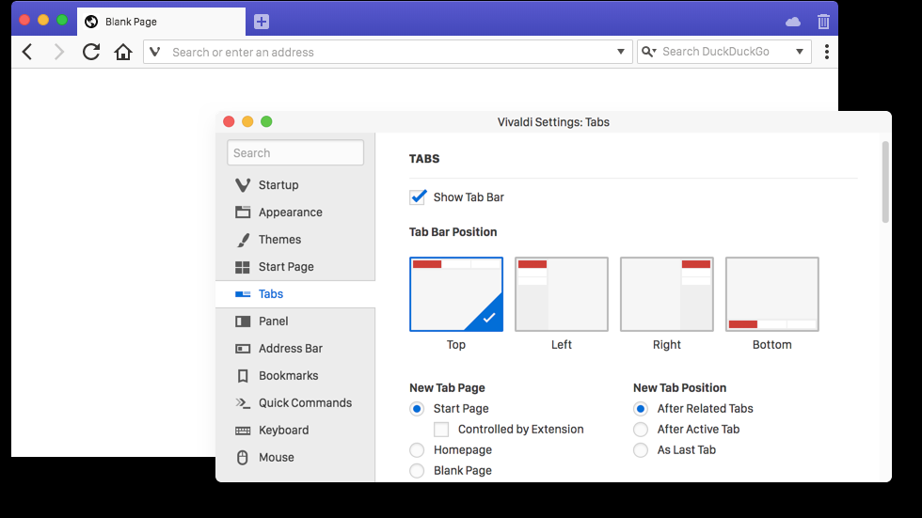
Unique Features - Vivaldi
Based on Chrome
Very customizable
Can change how tabs are handled
Rich set of privacy handling functions
Sync’d Browser data between devices is encrypted

